Slide 1

Essence bottle
Notes:
NOTE: Want a different image on this slide? Select the picture and delete it. Now click the Pictures icon in the placeholder to insert your own image.

Slide 2
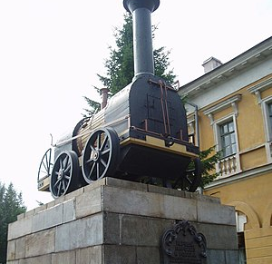
HTML, CSS, JAVASCRIPT, PYTHON
The Web is a subset of the internet.
Like every other computer network out there, the Web is made up of two main components: the web browser client and the web server.
The client requests the data and the server shares or serves its data. To achieve this, the two parties have to establish an agreement. That agreement is called the Application Programming Interface or in short, the API.
But this data has to be arranged and formatted into a form that's understandable by end-users who have a wide range of technical experiences and abilities.
This is where HTML, CSS, JavaScript and the whole concept of web development come into play.

Slide 3
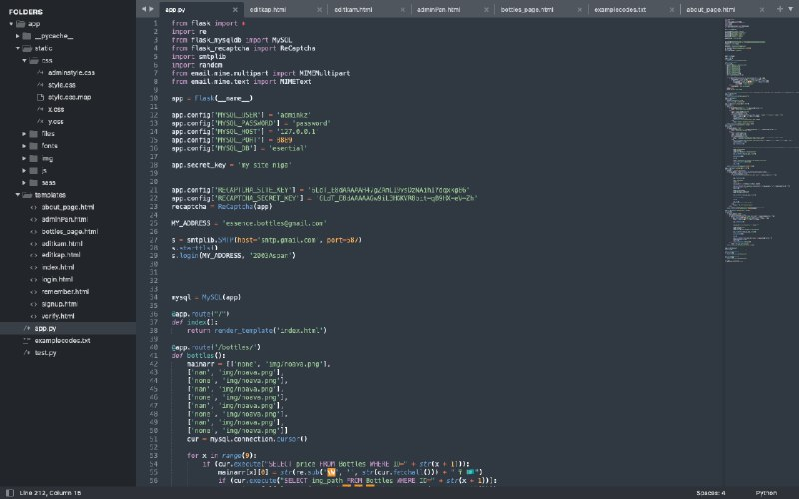
Essence project
Essence project is the eco product selling project. We have used html, css, javascript to our front-end part and python\django for back-end part. These are the newest technologies available in the market.

Slide 4
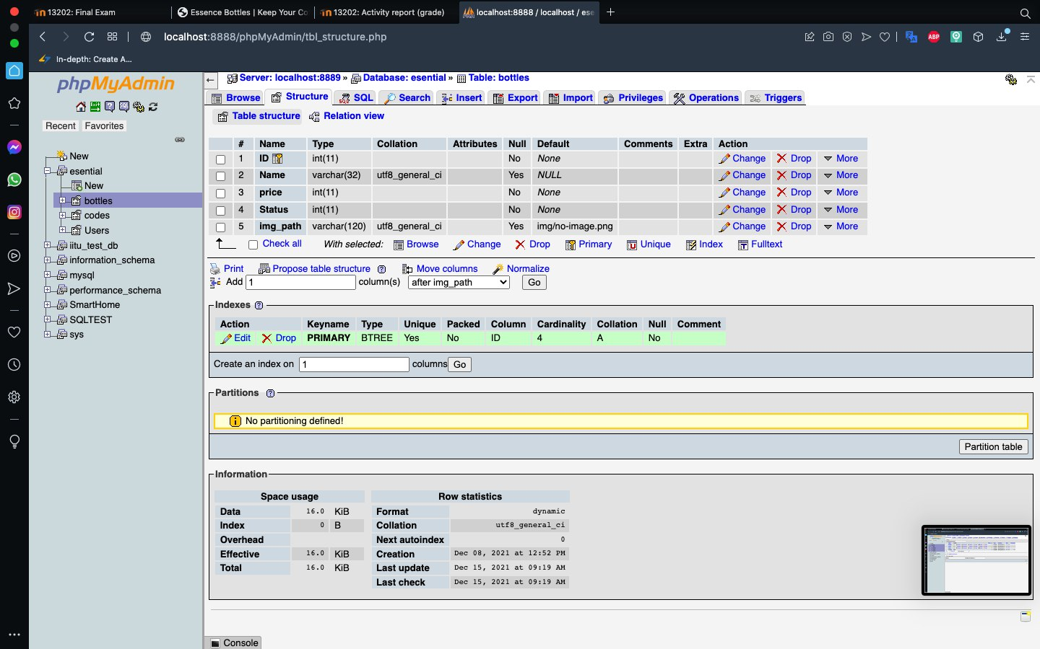
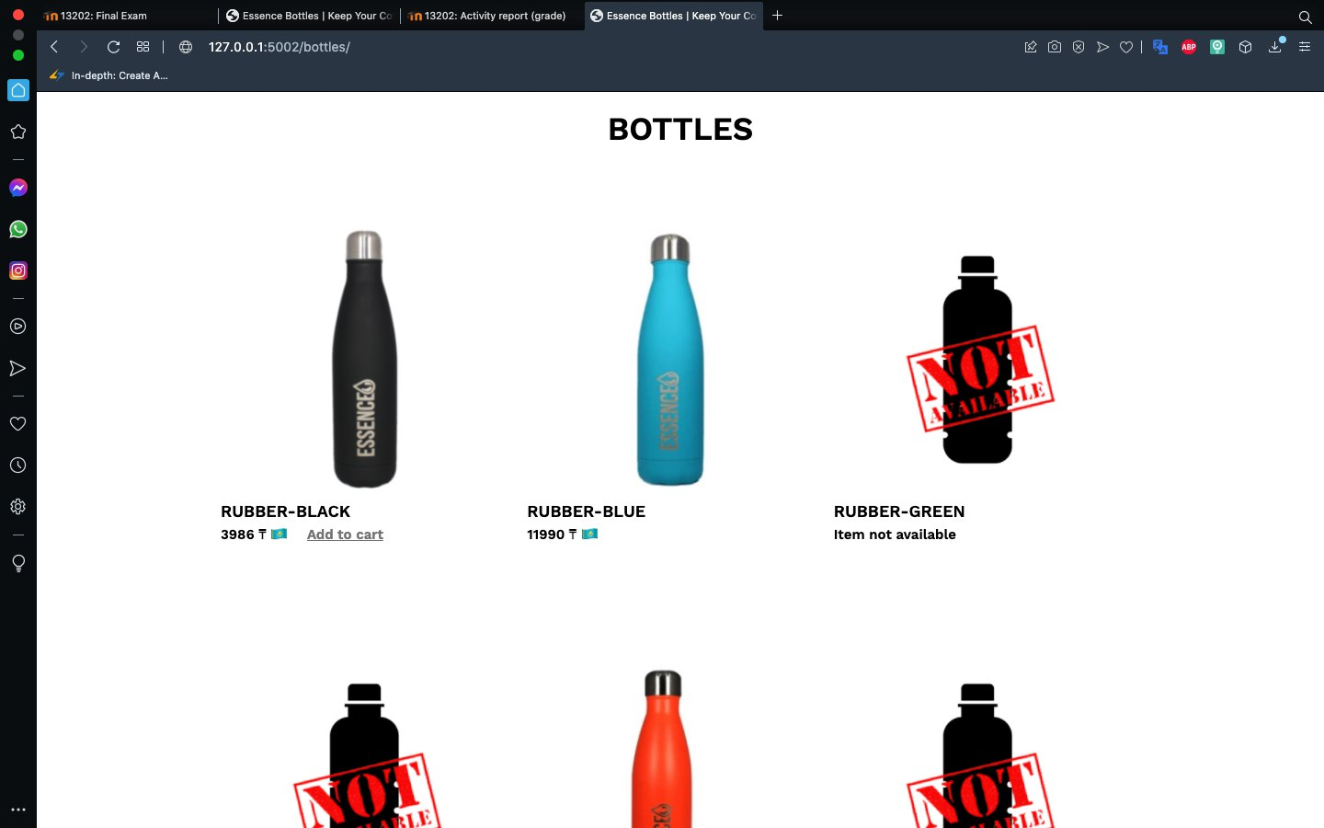
Database part

Slide 5
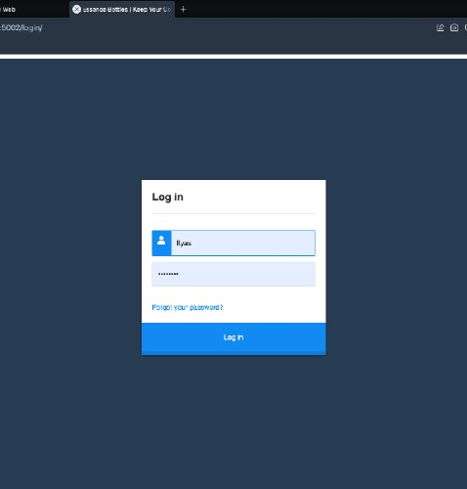
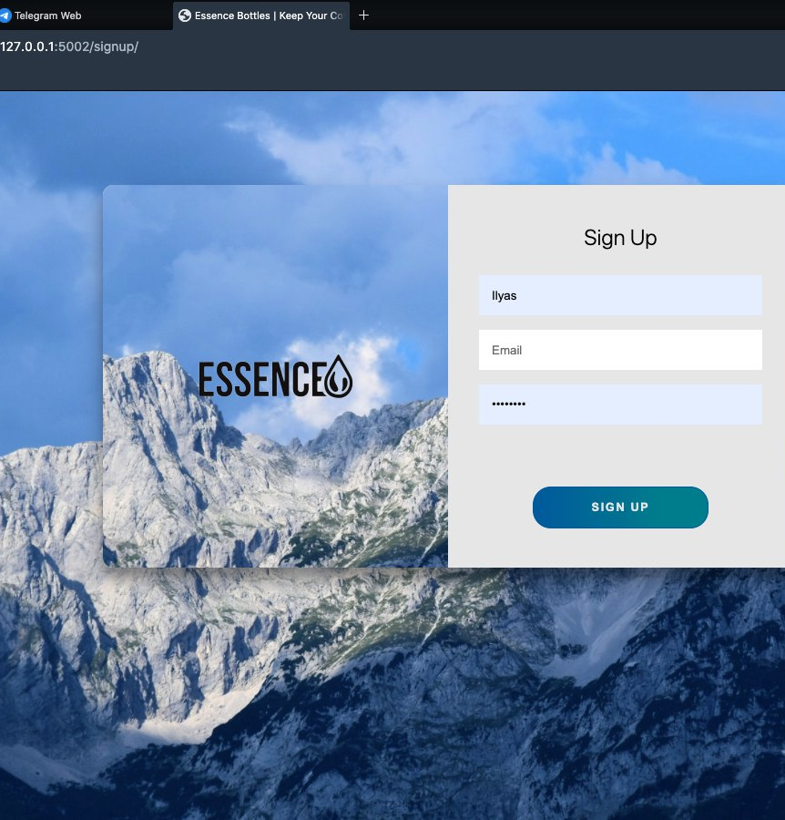
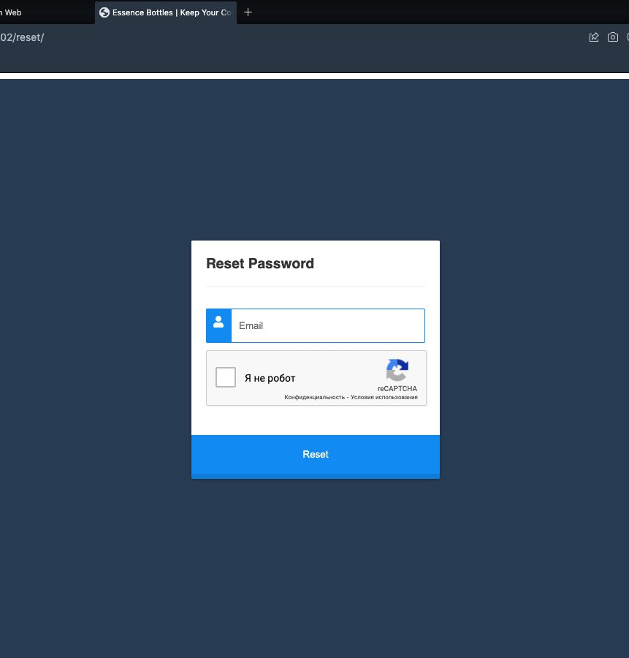
Log in part

Slide 6
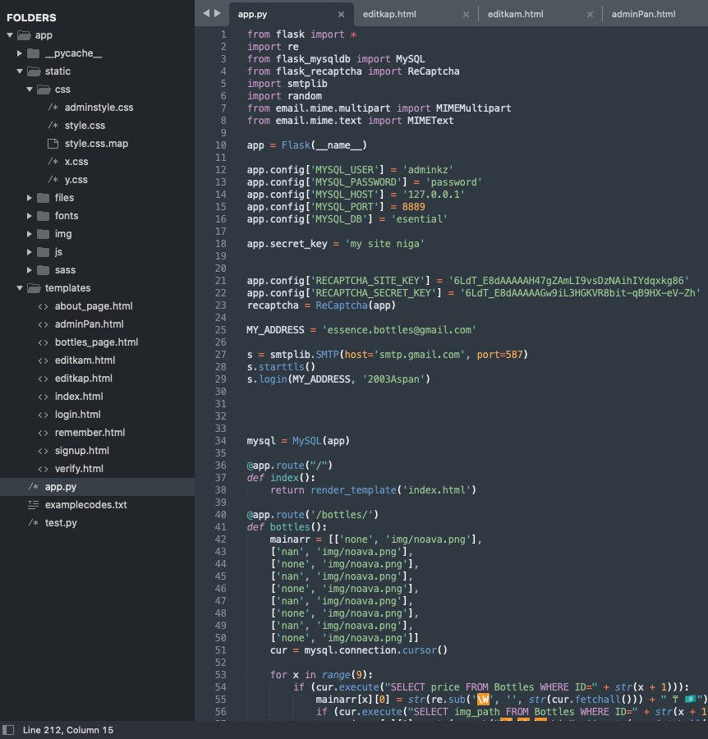
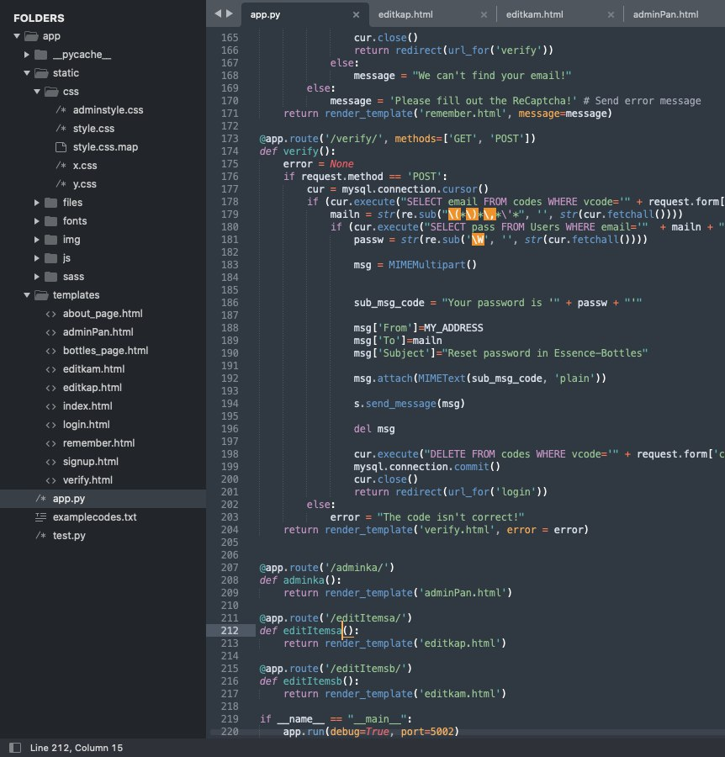
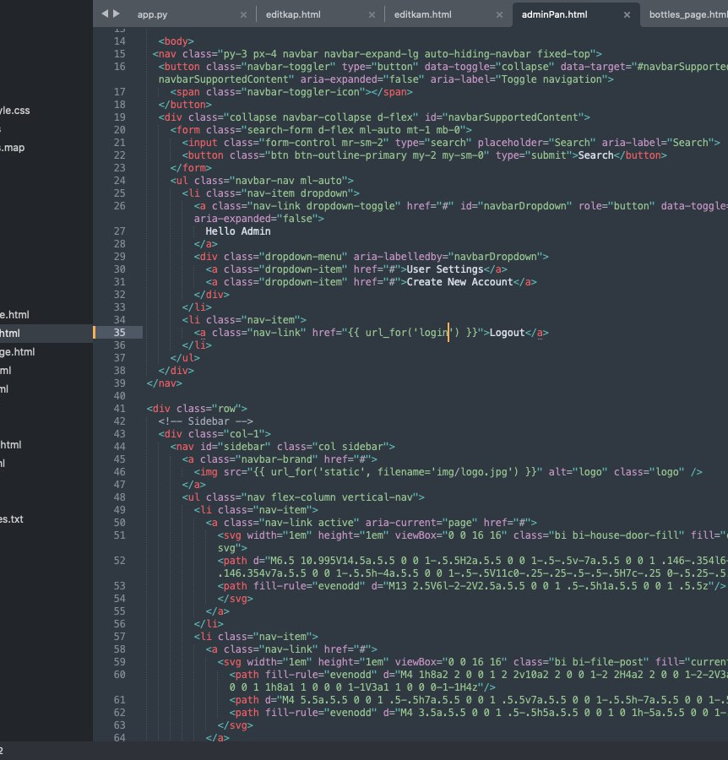
Back-end implementation

